Slide 1
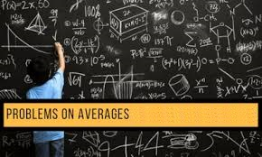

Slide 2
Content
Introduction
Formula
Deviation method
Type 1 problems: Combined average
General equation
Balance method
Type 2 problems: Change in average
General equation
Equal distribution method

Slide 3
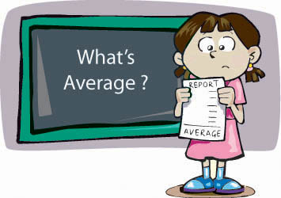
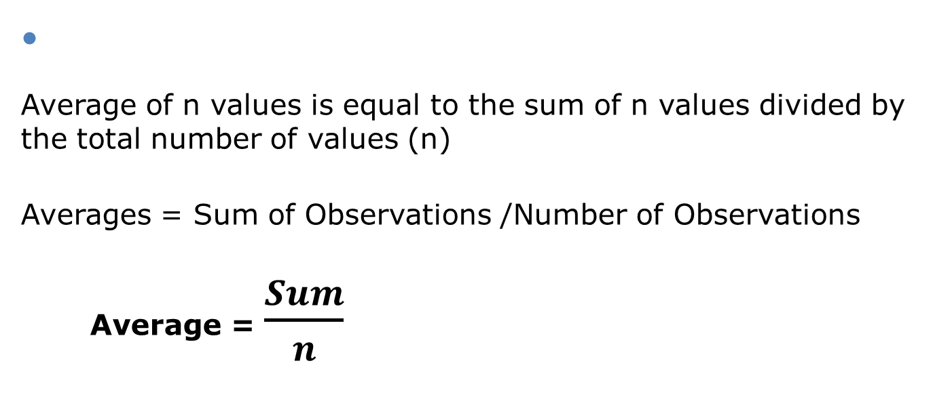
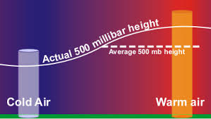
1 INTRODUCTION
What is an average ??

Slide 4
I Formula
Numbers | Sum | Average (Sum/n)
First n numbers | n(n+1)/2 | (n+1)/2
First n odd numbers | n^2 | n
First n even numbers | n(n+1) | (n+1)
First n square numbers | n(n+1)(2n+1)/6 | (n+1)(2n+1)/6
Consecutive numbers | n(first term + last term)/2 | (first term + last term)/2

Slide 5
Points to remember
If the value of each item is increased by the same value P, then the average of the group or items will also increase by p.
If the value of each item is decreased by the same value p, then the average of the group or items will also decreased by p.
If the value of each item is multiplied by the same value, then the average of the group or items will also be multiplied by p.
If the value of each item is divided by the same value P (P ≠ 0), then the average of the group or items will also be divided by p.
The average of a group of items will always lie between the smallest value in the group and largest value in the group – i.e., the average will be greater than the smallest value and less than the largest value in the group

Slide 6
Note:
Average of consecutive numbers can also be written as
(2nd term + 2nd last term)/2 or (3rd term + 3rd last term)/2 and so on.
For odd number of consecutive values, the middle term will be the average.

Slide 7

Example 1.Find the average of following number
1, 3, 5, 7, 9, 11, 13, 15, 17, 19, 21
A) 9
B) 11
C) 12
D) 13
Ans: B

Slide 8

Example 2. The average of 20 numbers is zero. Of them, at the most, how many may be greater than zero?
A) 0
B) 1
C) 10
D) 19
Ans: 19

Slide 9
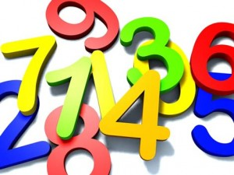
Example 3. The average of 7 consecutive numbers is 20. The largest of these numbers is :
A)27
B)26
C)24
D)23
Ans: D
Let the numbers be x, x + 1, x + 2, x + 3, x + 4, x + 5 and x + 6,
Then (x + (x + 1) + (x + 2) + (x + 3) + (x + 4) + (x + 5) + (x + 6)) / 7 = 20.
or 7x + 21 = 140 or 7x = 119 or x =17.
Latest number = x + 6 = 23

Slide 10
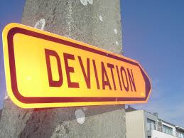
Ii DEVIATION METHOD
Example: Find the average of 20,23,28,24,25
Assume any number as the average, say 25.
Find the deviation for all the given values.
Numbers - 20 23 28 24 25
Deviation - -5 -2 +3 -1 0
Total deviation - -5
Average deviation - -5/5
(total/n) = -1
Final average = assumed average + average deviation
= 25 + (-1)
= 24

Slide 11
Note: It is better to assume the average between the highest value and the lowest value because it will always be between them.

Slide 12

Example 4. Find the Averages of 61,70,67,77,103,90
A)78
B)88
C)98
D)None
Ans: A
Notes:
Ans 78

Slide 13
Q) What will be the average of 1, 2, 3, 4………………………51, 52, 53?
Q) Calculate the average of the squares of natural numbers from 1 to 25.

Slide 14
2. COMBINED AVERAGE/WEIGHTED AVERAGE
Class A
0
Class B
100
What is the combined average?
50 marks??
NO
We cannot determine the average without knowing the number of
students in each class
The combined average depends on the number of students and the average in each class

Slide 15

Example: There are 36 students in class A whose average is 30kg and 24 students in class B whose average is 40kg. What will be the average if the classes are combined?
2.i General equation
Avg₃₆= 30, Avg₂₄ = 40
Total weight of class A = 30 x 36
Total weight of class B = 40 x 24
Overall average = (Total weight of class A) + (Total weight of class B) / Number of students in class A + Number of students in class B
= (30 x 36) + (40 x 24) / 36 + 24
= 34

Slide 16
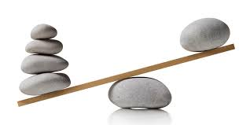
2.Ii BALANCE METHOD:
The principle of this concept is that the weight in the balance is inversely proportional to the distance of the pivot.
Where,
W_{a} – Class A weight W_{b} – Class B weight
Avg_{a} – Class A average Avg_{b} – Class B average
Avg_{c} – combined average
W_{a}
W_{b}
Avg_{a}
Avg_{c}
Avg_{b}

Slide 17
There are 36 students in class A whose average is 30kg and 24 students in class B whose average is 40kg. What will be the average if the classes are combined?
Step 1: Find the ratio of the weights of A and B
= 36:24
= 3:2
Step 2: Inverse the weights to get the distance ratio
= 2:3
36
3:2
24
30
40
36
3:2
24
30
2:3
40

Slide 18
Step 3: Split the distance between the averages in the ratio 2:3
Here the distance from 30 to 40 is 10. So 10 should be split in the ratio 2:3 as 4 and 6.
The combined average is (30+4) or (40-6) = 34
36
3:2
24
30
34
40
4
6
2:3

Slide 19
Note: Of these 5 values any one can be unknown which we have to find using the other 4 values.

Slide 20

Example 5. In class A there are 63 students whose average is 32, and in class B there are 21 students whose average is 44 , then find the overall average?
A)33
B)35
C)36
D)38
Ans: B

Slide 21
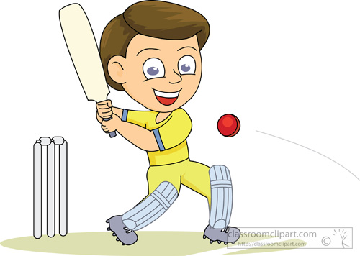
Example 6. In a first 10 overs cricket game run rate was 3.2. what should be run rate in the remaining 40 overs to reach the target 282 runs?
A)6.25
B)6.5
C)6.75
D)7
Ans: A

Slide 22

3. Change in average
Example: Average of 5 students marks is 30. If one student having 90 mark is added to the team then what will be the new average ?
3.i General equation
Avg₅ = 30
No of students = 5
Sum₅ = 30x5
= 150
Sum₆ = 150+90
= 240
Avg₆ = 240/6
= 40

Slide 23
3.Ii EQUAL DISTRIBUTION method:
All the problems in this concept are solved by assuming all the values as average itself.
Step1: Assume all the values to be 30.
30 30 30 30 30
If the new mark is also 30 then the average will remain the same.
30 30 30 30 30
Step2: Finding the extra values-
But the actual new mark is 90, which means extra 60 is added to the values.
30 30 30 30 30
90
30
30
+60

Slide 24
Step3: Distributing the extra values equally-
The extra 60 should be divided equally among 6 values as 10 each.
30 30 30 30 30 30
+10 +10 +10 +10 +10 +10
40 40 40 40 40 40
∴ the new average is 40

Slide 25

Example 7. Average of 4 students marks is 50 and one student having marks has 200, is added to the team , what is new average ?
A)70
B)80
C)90
D)None
Ans: B

Slide 26

Example 8. Average of 6 students marks is 60 , what is the new average if a student of marks 110 is taken out ?
A50
B)55
C)60
D)None
Ans: A

Slide 27
*If the number of values is unknown:
Avg_{n} = 30
Avg_{n+1} = 40
New number= 90
Old values 30 30 30…….
+10 +10 +10……
New values 40 40 40…….
Total extra value added is 60 (30 90)
This 60 is divided as 10 each which means there should be 60/10 = 6 values
∴ New values, n+1 = 6
Old values, n = 5

Slide 28
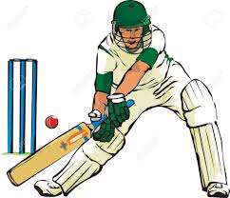
Example 9. A batsman having average 40 makes 90 runs in his last inning thereby his average increases by 2. Find the number of matches he has played.
A)10
B)50
C)25
D)24
Ans: C

Slide 29
*If the average is unknown:
Avg₅ = x
Avg₆ = x+10
New number= 90
Old values x x x x x
New values x+10 x+10 x+10 x+10 x+10 x+10
Total extra value added is 60 (6 x 10)
This 60 is being increased because of the new number 90 which means the initial value has to be 30.
∴ Avg₅, x = 30
Avg₆, x+10 = 40
x
+10 +10 +10 +10 +10 +10
New number

Slide 30
Example 10. The average marks of 12 students increases by 3 if a new student having mark 79 is included. The average mark of the students is(old)?
A) 37
B) 40
C) 43
D) 82
Ans: B

Slide 31

Example 11. The average weight of 8 men having average weight 40 kg is increased by 2 kg when a new man is included. The weight of the new man is
A) 56
B) 58
C) 96
D) 98
Ans: B

Slide 32
*If the new number is unknown:
Avg₅ = 30
Avg₆ = 40
New number= ?
Old values 30 30 30 30 30
New values 40 40 40 40 40 40
Total extra value added is 60 (6x10)
Already the number has to be 30 to maintain the average.
∴ the new number should be 30 + 60 = 90
30
+10 +10 +10 +10 +10 +10
New number

Slide 33
Example 12: The average marks of 65 students in a class were calculated as 150. It was later realized that the marks of one of the students was calculated as 142, whereas his actual average marks were 152. What is the actual average mark of the group of 65 students? (Rounded off to two digits after decimal)
A) 149.25
B) 150.15
C) 153.75
D) 151.15
Ans: B

Slide 34
Example 13: Twelve years ago, the average of the ages of the members of a joint family having ten members was 25 years. Four years later a member aged 50 years died and a child was born in the family that year. Four years after that, another member aged 50 years died and another child was born. Find the present average age of the members of the family (in years).
A) 27
B) 28
C) 36
D) 30
Ans: 27

Slide 35
Example 14: Srikanth earned an average of Rs. 16,00 per month from January to June. Then, he earned Rs. 1500, Rs, 1800, Rs, 1900 and Rs. 2150 respectively during the months July, through October. During November he earned 50% of what he earned in December. If his average earnings for the entire year is Rs. 1,600. Find his earnings in the month of November.
A) 550
B) 650
C) 750
D) 850
Ans: C

Slide 36


